Slide 1
JSON

Slide 2
Outline
What is JSON?
  Syntax
  Example
  Schema
Validating JSON file
Using JSON with Python
  Writing a JSON file
  Reading a JSON
Accessing JSON Properties in Python

Slide 3
What is JSON?
“JSON” stands for “JavaScript Object Notation”
  Lightweight data-interchange format
  Despite the name, JSON is a (mostly) language-independent way of specifying objects as name-value pairs
  Structured representation of data object
  Can be parsed with most modern languages
JSON Schema can be used to validated a JSON file

Slide 4
JSON Syntax Rules
JSON is almost identical to python dictionary except for
  In JSON, true and false are not capitalized
  In JSON, null is used instead of None
Uses key/value pairs: {“name”: “John”}
Uses double quotes around KEY and VALUE
Must use the specified types
File type is “.json”
A value can be: A string, a number, true, false, null, an object, or an array
Strings are enclosed in double quotes, and can contain the usual assortment of escaped characters

Slide 5
JSON Example
{
"name": "John Smith",
"age": 35,
"address": {
"street": "5 main St.",
"city": "Austin"
},
"children": ["Mary", "Abel"]
}
Notes:
This is a single JSON object for a person. It’s wrapped in curly braces and uses the key/value pairs.
The first pair, which is the name, uses a string as the value, John Smith, must be wrapped in double quotes.
The second one is the number, and note that the number is not wrapped in double quotes.
The next is address which is actually an embedded object with a street and a city.
The last one is an array is an array of strings.

Slide 6
JSON Schema
A JSON Schema allows you to specify what type of data can go into your JSON files.
It allows you to restrict the type of data entered.

Slide 7
JSON Schema
{
"type": "object",
"properties": {
"name": {
"type": "string"
},
"age": {
"type": "integer"
},
"address": {
"type": "object",
"properties": {
"street": {
"type": "string"
},
"city": {
"type": "string"
}
}
},
"children": {
"type": "array",
"items": {
"type": "string"
}
}
}
}

Slide 8
Validating JSON file
The following website can be used to validate a JSON file against a schema
  https://www.jsonschemavalidator.net/
Paste both the schema and the corresponding JSON file

Slide 9
Using JSON with Python
To work with JSON (string, or file containing JSON object), you can use Python's json module.
  import json
Notes:
In Python, JSON exists as a string.
p = '{"name": "Bob", "languages": ["Python", "Java"]}‘
It's also common to store a JSON object in a file.
Opening a file using with is as simple as: with open(filename) as file: # it automatically closes the file when done.

Slide 10
Loading JSON data from a file
Example:
  def load_json(filename):
  with open(filename) as file:
  jsn = json.load(file)
  #file.close()
  return jsn
  person = load_json('person.json')
This command parse the above person.json using json.load() method from the json module. The result is a Python dictionary.
Notes:
(1) In Python, JSON exists as a string.
p = '{"name": "Bob", "languages": ["Python", "Java"]}‘
It's also common to store a JSON object in a file.
(2) json.loads(s): load JSON data from a string.
(3) json.load(f): load JSON from a file.
Opening a file using with is as simple as: with open(filename) as file: # it automatically closes the file when done.

Slide 11
Writing JSON object to a file
Example:
  person = { "name": "John Smith", "age": 35, "address": {"street": "5 main St.", "city": "Austin"}, "children": ["Mary", "Abel"]}
  with open('person_to_json.json', 'w') as fp:
  json.dump(person, fp, indent=4)
Using json.dump(), we can convert Python Objects to JSON file.
Notes:
(1) In Python, JSON exists as a string.
p = '{"name": "Bob", "languages": ["Python", "Java"]}‘
It's also common to store a JSON object in a file.
(2) json.dumps(s): output JSON object as a string.
(3) with open('person_to_json.json', 'w') as fp:
json.dump(person, fp, indent=4)
In the first line of code, the file person_to_json.json gets created and opened as the variable fp.
In the second line, your dict person gets written into the person_to_json.json.

Slide 12
Accessing JSON Properties in Python
  Example:
  Assume that you already loaded your person.json as follows.
  person = load_json('person.json')
  To access the property "name"
Print(person["name"])
John Smith

Slide 13
Accessing JSON Properties in Python
  Example:
  Assume that you already loaded your person.json as follows.
  person = load_json('person.json')
  To access the property “age"
person["age"]
35

Slide 14
Accessing JSON Properties in Python
  Example:
  Assume that you already loaded your person.json as follows.
  person = load_json('person.json')
  To access the property “street"
print(person["address"]["street"])
5 main St.

Slide 15
Accessing JSON Properties in Python
  Example:
  Assume that you already loaded your person.json as follows.
  person = load_json('person.json')
  To access the property “street"
print(person["address"]["city"])
Austin

Slide 16
Accessing JSON Properties in Python
  Example:
  Assume that you already loaded your person.json as follows.
  person = load_json('person.json')
  To access the property “street"
print(person["children"][0])
Mary

Slide 17
Accessing JSON Properties in Python
  Example:
  Assume that you already loaded your person.json as follows.
  person = load_json('person.json')
  To access the property “street"
print(person["children"][1])
Abel

Slide 18
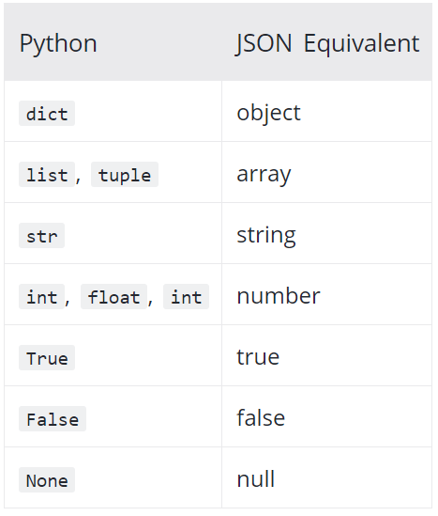
Python – JSON Objects
Notes:
array: Ordered list of 0 or more values. Wrap in square brackets
object: Unordered collection of key/value pairs
number: No difference between integers and floats
integer
string: Use double quote
boolean: true or false
null: Empty value

Slide 19
Credit:
https://www.youtube.com/watch?v=wI1CWzNtE-M
https://www.programiz.com/python-programming/json

